Slide 1

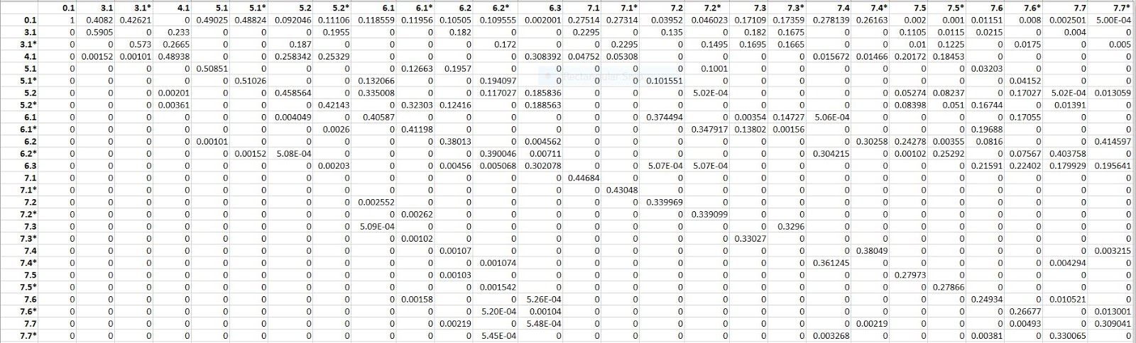
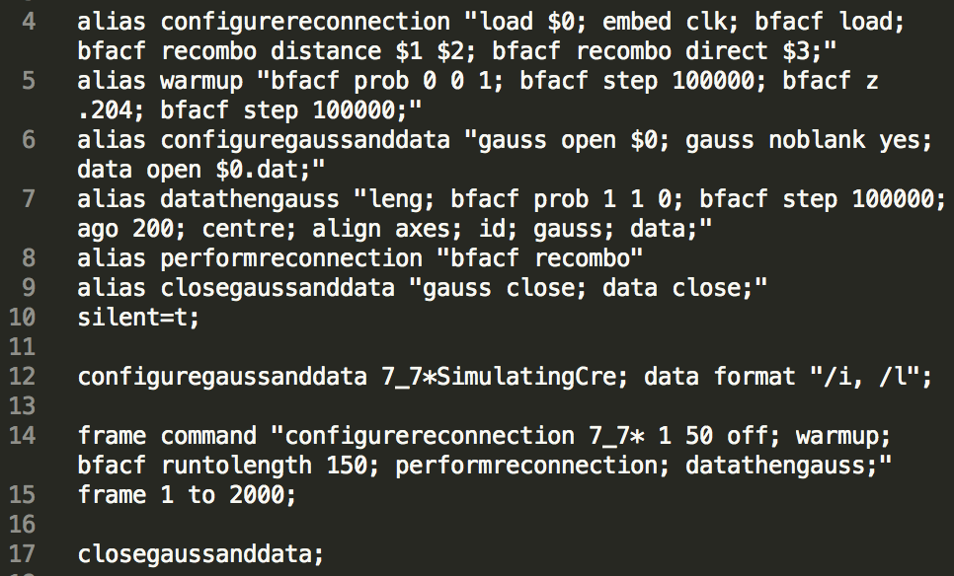
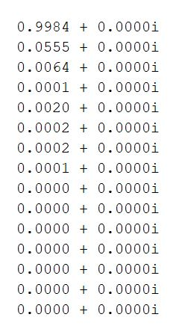
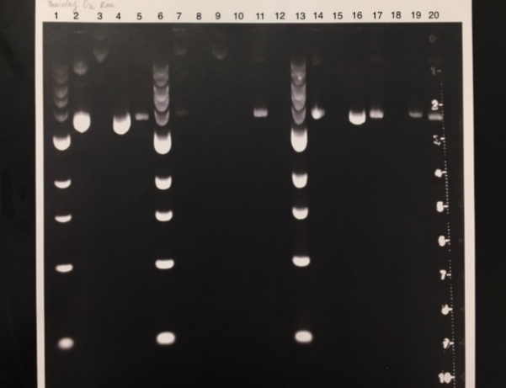
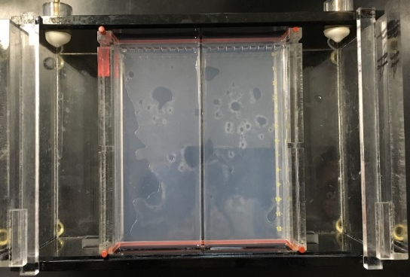
Analyzing the Topological Transformation Probability of DNA Using Computational Models of Cre Recombinase Stella Li¹, Janani Sekar², Jeffrey Yang³ ¹Robert Louis Stevenson School, ²James Logan High School, ³Harker School COSMOS at University of California, Davis
Introduction
Results
Discussion
Imagine the headphones in your pocket. When you take them out after a while, everything is knotted. Inside cells, this phenomenon occurs in tightly packed DNA molecules. Proteins and enzymes, such as Cre, interact with knotted DNA in processes like replication, transcription, and more. To model this enzyme activity, a simulation through topological modeling program KnotPlot™ and the BFACF[4] algorithm were used to study recombination on all topological knots up to seven crossings. The data from these simulations was organized in a probability matrix and used to determine the steady state and efficiency of transforming into an unknot. To test our model’s accuracy, our results were compared to real experimental data. Accepting the general statement that DNA prefers to be an unknot, we hypothesize the Cre works in favor of transformations to unknots. Research in this field has potential pharmaceutical applications to improve the efficiency of enzyme activity in transforming circular DNA chains into the unknotted form.
To test accuracy and reproducibility of simulations, chi square tests were conducted on 2 trials of each type simulation. A chi square test was also done to test for differences in data caused by distinguishing chirality. The result shows that chirality does not influence the resulting knot type after recombination.
The probability maps show a high probability that a knot will recombine to itself. The graph also suggests that knots are likely to recombine into a unknot, which supports the belief that DNA prefers to be in an unknotted state. Besides the unknot itself, torus knots (3.1, 5.1, and 7.1) are more likely to recombine into an unknot. After performing a type 1 tangle (inverted orientation)[3] at any position of the torus knot, the knot transforms into a twisted unknot. Then Reidemeister I moves can be performed on the twisted knot to reach an unknot.
Transformation Probability of Knots Combining Mirror Images
Figure 7. Probability matrix from trials that included mirrored knots
Above is the probability matrix generated by Java showing the probability of each knot transforming into another knot.
Figure 10. Knot 3.1 [1]
Probability Graph of Transformations to Unknot over 20 Recombos
The pathway probability graphs also show that some knots transform into an unknot in fewer steps, hence suggesting that some knots have a higher efficiency of transforming into an unknot. The probability of any knot transforming into an unknot eventually converges to a constant value (also given by the steady state). Again, the pathway graph supports a high chance that the torus knots recombine into an unknot.
Methods
Computer Simulations:
1) All simulations were done using scripts in KnotPlot™. A script was written to model DNA recombination on all 15 knots between 0.1 and 7.7 and then revised to include mirrored image knots. Knots 0.1, 4.1, and 6.3 are achiral, so the 2nd KnotPLot™ script analyzed 27 knots. Each script was run twice.
Figure 1. KnotPlot Code [1]
Figure 11. Knot 3.1 [2]
Figure 12. Knot 3.1 [2]
Figure 13 Knot 3.1 [2]
Figure 8. Graph of transformation probabilities at 20 transformations
The final trial in our experiment limited the arc length between recombination sites to ⅓ the knot length - proportional to the distance between LoxP sites. The first major difference in this trial was that the probability of becoming an unknot increased for most knot types, especially the ones with more intersections. More specifically, only six out of twenty-seven knots had a lower probability of turning into an unknot in this trial: 3_1, 4_1, 5_1, 5_1*, 7_1 and 7_1*. These results suggest that if a knot is more complicated, when the recombination sites are restricted to a distance, Cre is more likely turn the knot into an unknot.
2) A Java script then counted the total occurrence of each knot in recombination and organized values in a spreadsheet. A third simulation more accurately modeled Cre by limiting recombination sites to ⅓ the length of the knot.
3) To analyze data produced from the simulation, a MATLAB script generated a probability matrix for each trial and calculated percent transformations into each knot.
4) A MATLAB program also calculated the eigenvalues of the probability matrix. This resulted in an eigenvalue of 1 and a corresponding eigenvector showing steady state that our data converges to.
Figure 5. Probability Map 1
The probability of each knot transforming into an unknot within 20 steps was calculated from the probability matrix. For n+1 steps of recombination, the row vector of each knot transforming to an unknot in n steps was multiplied by the column vector of the knot’s total transformations. This model does not assume that the unknots stay unchanged.
This figure shows the average transformation probability calculated in the first 2 trials where chiral knots were not distinguished but considered to be the same as the regular knot..s
Transformation Probability with Parameters to Model Cre
Probability Graph of Transformations to Unknot Over 20 Recombos
Overall, the difference in probabilities grew as the knot complexity increased, and more data will be needed to account for this. Two factors in this research may have caused errors: finding Z-value for BFACF and considering float point rounding in Java. The Z-Value represents the optimal size ratio that the algorithm weights for the different changes in the knot length.
Figure 2. Steady state vector from trial 1
Lab Work:
To obtain experimental data for comparison to KnotPlot simulations, in vitro Cre reactions were conducted in a lab environment. The following procedure was followed:
1) Test the effect of GelRed on Cre-loxP reactions. (We were not sure if experimenting on DNA from a gel stained w/ GelRed would work. The results suggested that DNA is more supercoiled due to GelRed.)
2) Pour a gel half with GelRed and half without. Extract DNA from side without stain.
3) Run gel and isolate DNA strands of specific knot types.
4) Let DNA sink out from the gel and run Cre reaction again on the extracted DNA.
5) Run gel again and quantitatively analyze the percentage of each resulting knot type by examining the brightness of each band after the second Cre reaction.
Future Research
Further research for this project entails generating more experimental lab data. Ideally, we would have as much lab data as computational data for comparison.
With more advanced programs, we could run more trials where the script stops once a knot is transformed an unknot. This method would improve accuracy in determining the efficiency of enzymes.
It would also be interesting to change the recombo range to see how the data is affected. Clearly, our data shifted when we limited the range between 1 and 50, suggesting that the effects of range can be mathematically modeled.
Furthermore, our simulation dismissed the fact that Cre only acts on molecules with negative writhe. Next steps would be to include these parameters. This research only considers inverted repeat DNA sequences for enzyme binding sites, ensuring that recombination creates knots, and not links. A more comprehensive model would also consider knots turning into links after recombination.
Figure 2. Testing Effect of GelRed
Figure 6. Probability Map 2
Figure 9. Graph of transformation probabilities within 20 transformations (unknots are not recombined)
This figure (above) maps out the probability of each knot recombining into every other knot . The data is from our trials that distinguished between knots and their mirror images and limited distance between recombination sites to 1/3 knot length to model Cre
For the second model, the assumption that a knot stays unchanged once it reaches the unknotted state was accepted, because it is generally assumed in the biological community that an unknot is the optimal state of DNA strands. The same procedures were followed to generate the graph.
Figure 3. Making Separated Gel
Acknowledgements: First and foremost, a huge thanks to COSMOS for giving us the opportunity to conduct this research and providing all the resources needed. Furthermore, we are very grateful to our professors, Dr. Arsuaga, Dr. Vázquez, and Dr. Scharein, for leading us through this process. The lab portion of this project could not have been performed without the support and guidance of Keith Fraga, who helped design the experiment. Finally, thanks to all of our classmates along with Ali Heydari for providing unconditional support during this 4 week program!
Works Cited:
[1] M. Flanner, Recombination KnotPlot™ Code
[2]R. Scharein, KnotPlot™ (2018).
[3] Stolz, R., et. al (2017). Pathways of DNA unlinking: A story of stepwise simplification.
[4] Van Rensburg, E. J., & Whittington, S. G. (1991). The BFACF algorithm and knotted polygons.

